Slide 1
Comp 490/L Senior Design Project
Fall 2023
Project Proposal
Ooey GUI
Team Leader: Inderjit Singh

Slide 2
Agenda
Team members
Background Section
Project Summary
Project Importance
Project Impact
Project Approach
Q&A

Slide 3
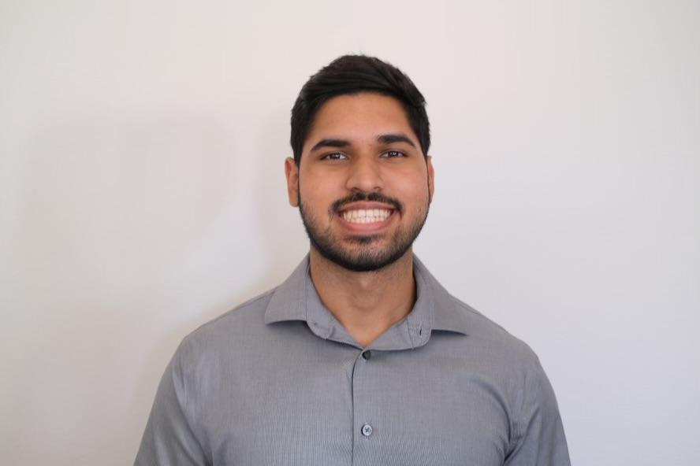
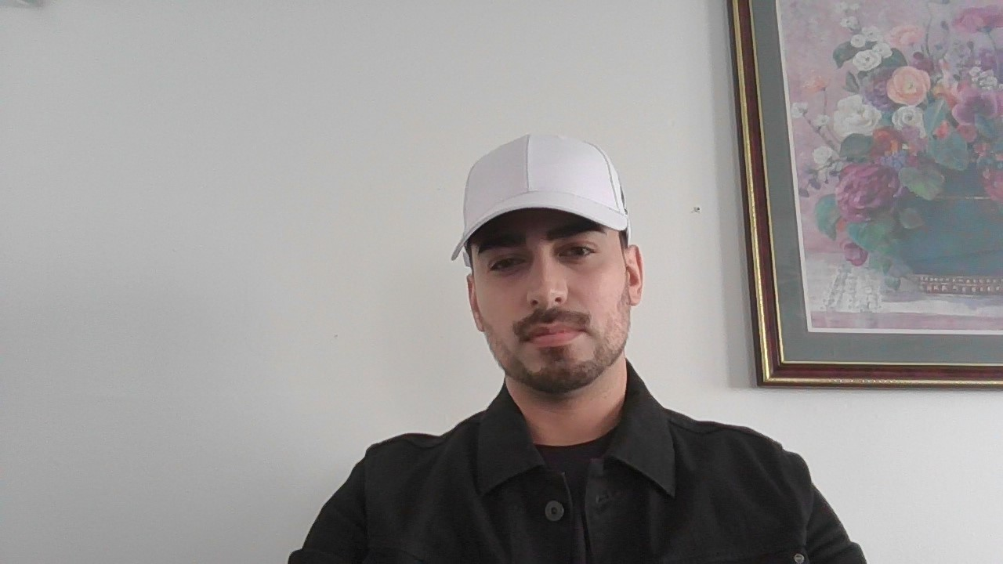
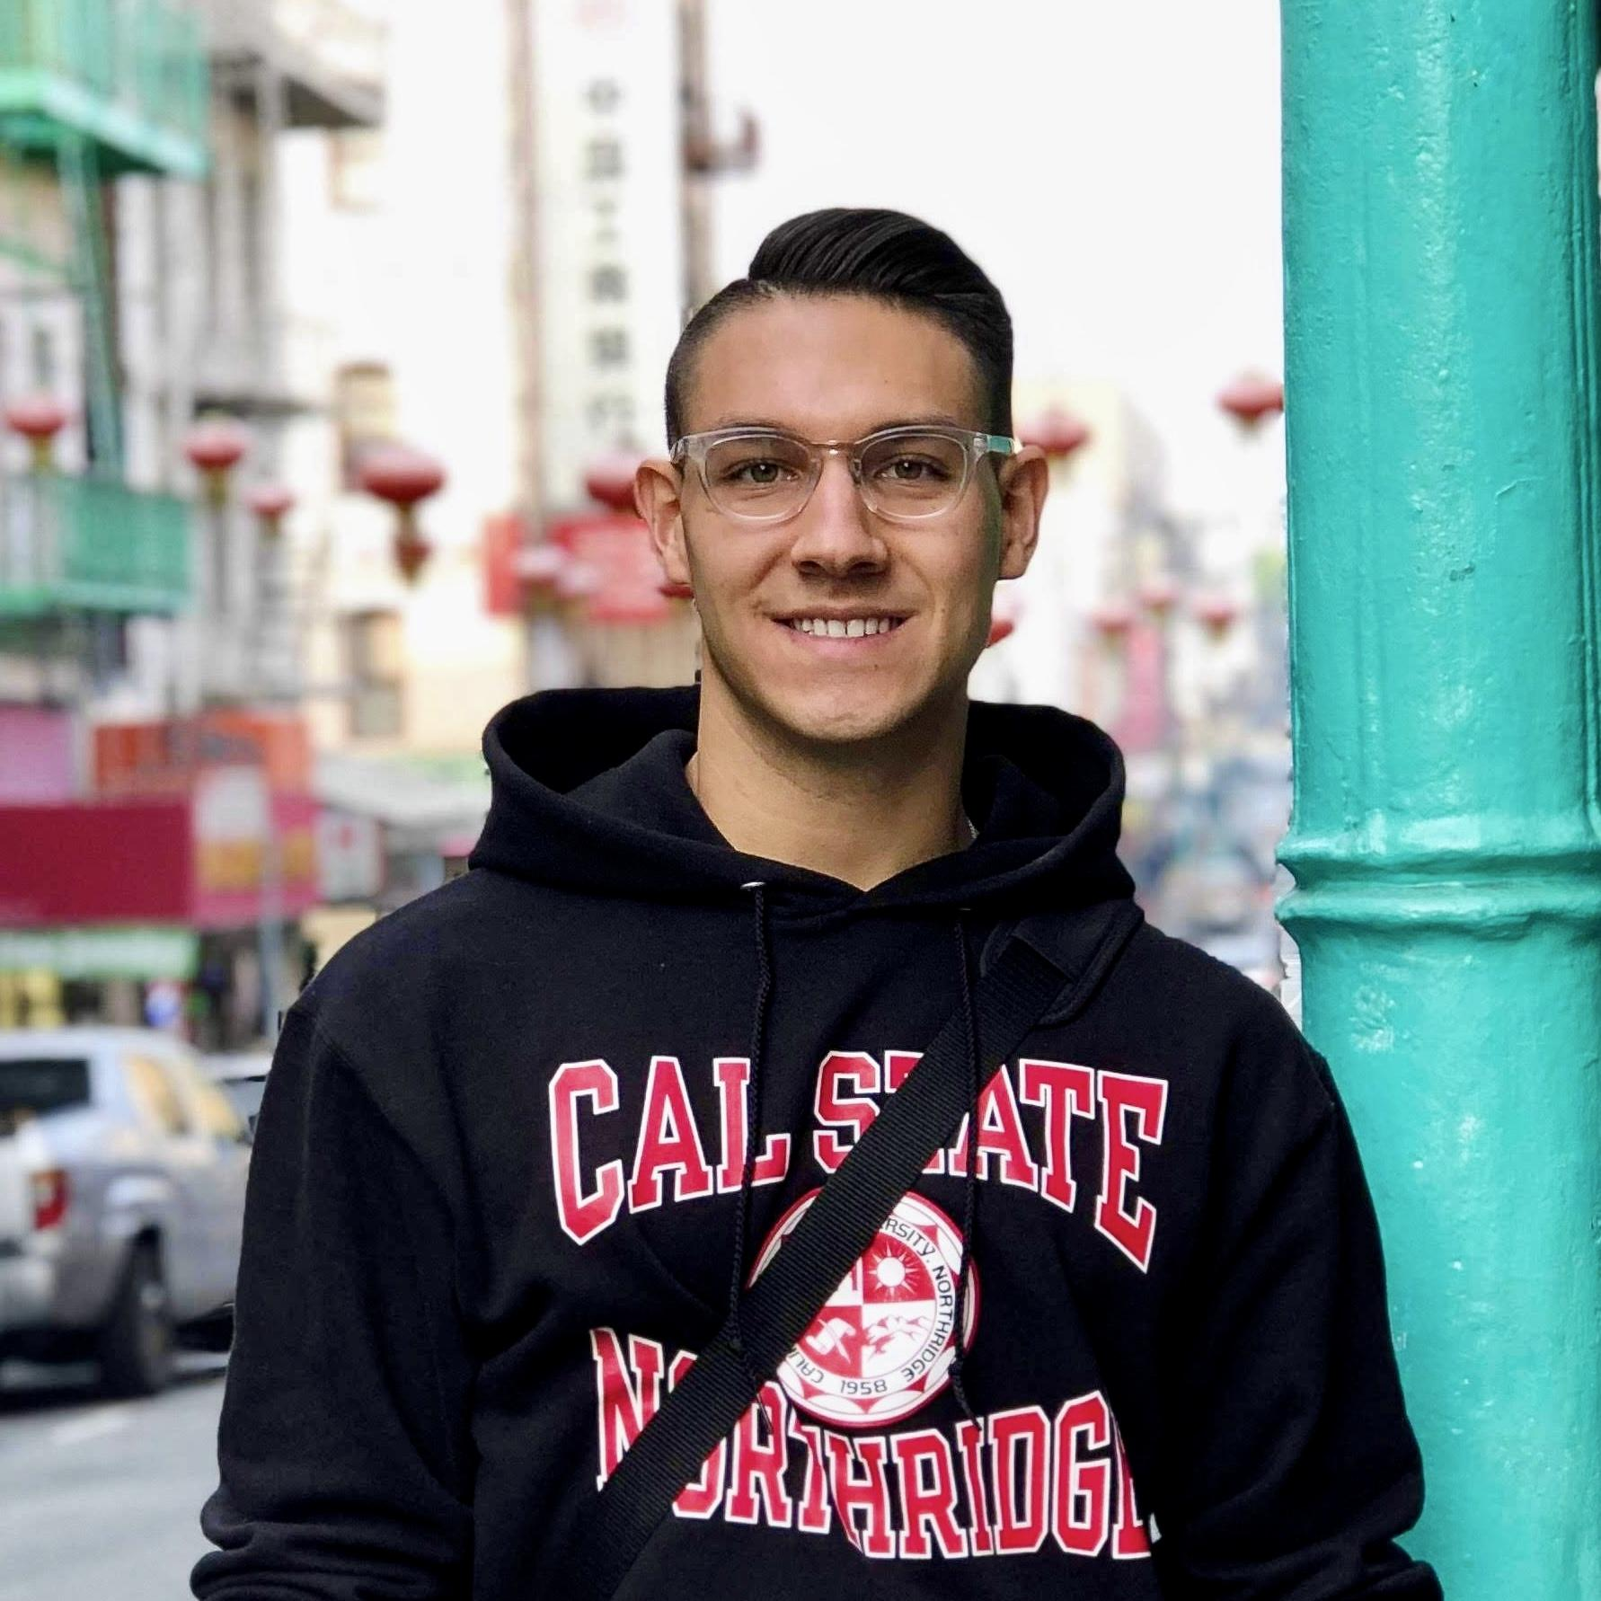

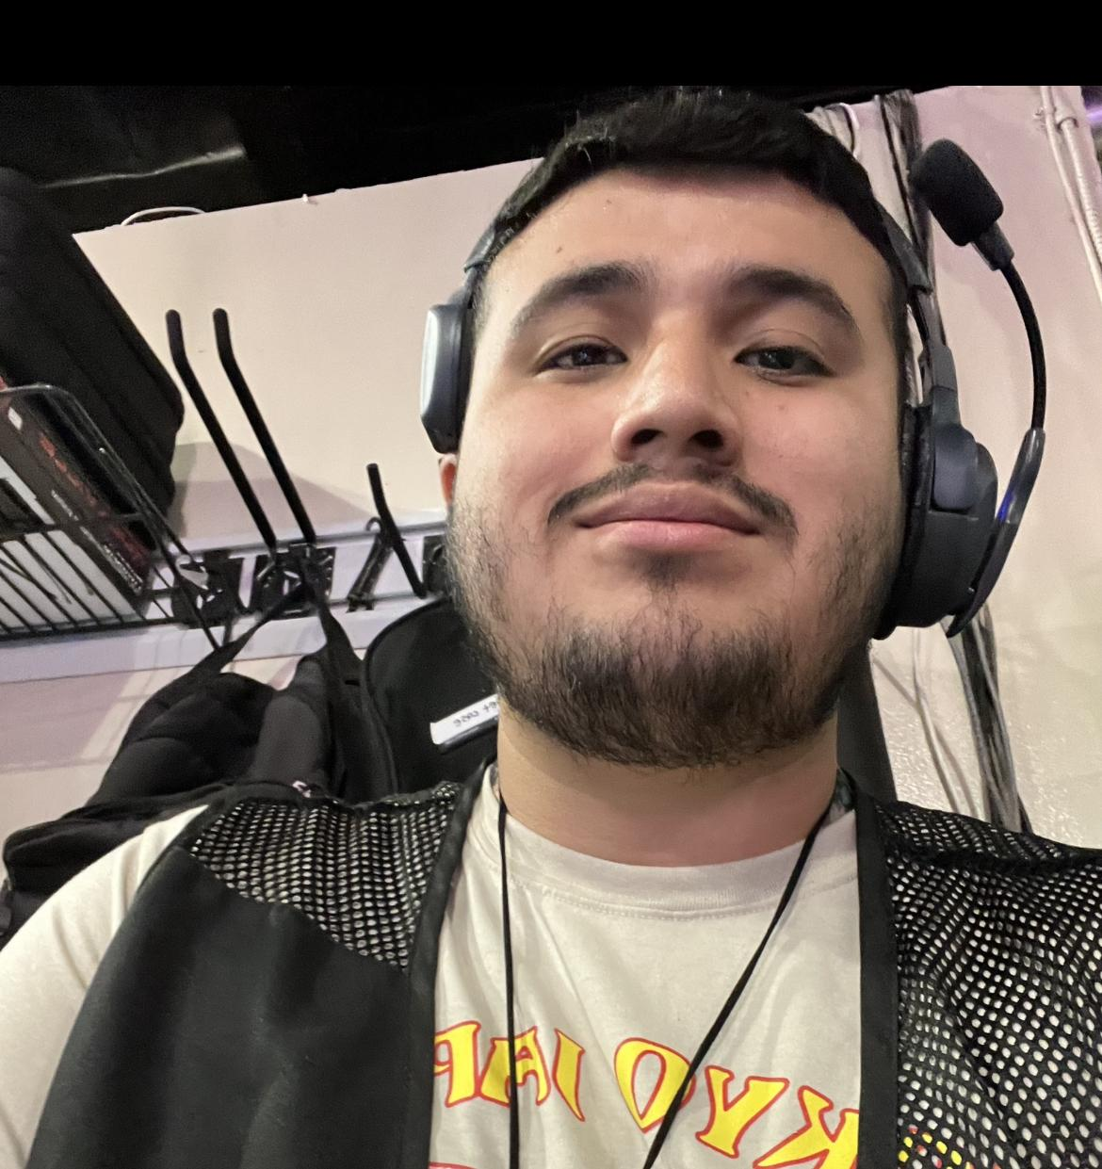
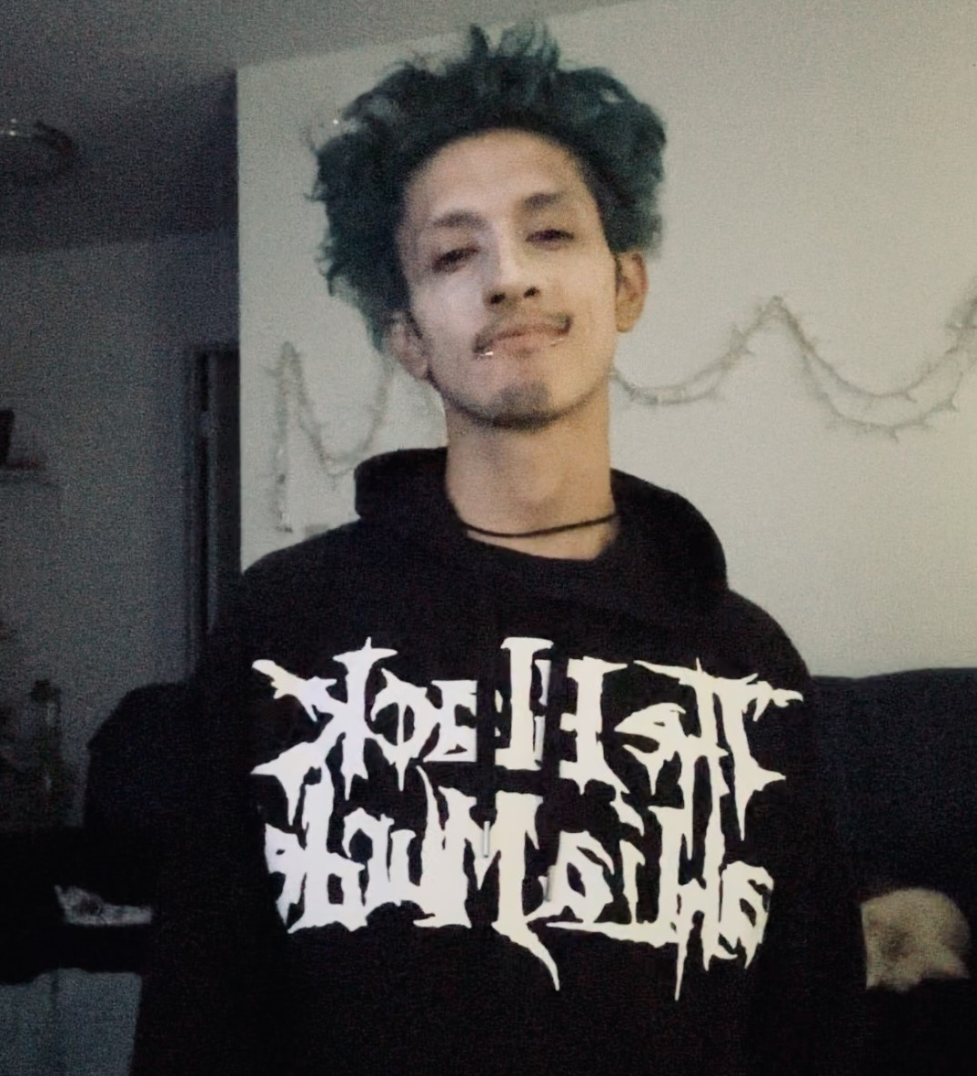
Team members
<Inderjit Singh>
Ivan Espinoza
Jarrett McIntire
Keith Chua
Peter Hernandez
Zamir Barbosa

Slide 4
Background Section
Some of our group members had the opportunity to learn about electronics through relevant ECE courses and with hands on experience tinkering with electronic components.
A majority of the group members are also taking Web Engineering I, while one group member has completed the course, which will provide experience with working on the mobile application needed for the drone.
<Inderjit> Experience in Java, C++, HTML, CSS, JavaScript, PHP, and MySQL.
<Ivan> Experience in Java,C/C++, Python and a bit of React.js. Have worked with machine learning libraries/frameworks, such as Sci-kit Learn, Pandas, Keras, Tensorflow, Seaborn, Matplotlib, and a bit of OpenCV. Currently learning C# and Flutter for graphical user interfaces and computer network software.
<Jarrett> Experience in Java, C++, C. Currently learning HTML, CSS, JavaScript, Python and MySQL.
<Keith> C++, C, Java. Applied practical knowledge of electronics.
<Peter> Experience in Java, C, Python. Currently re/learning HTML, CSS, JavaScript, and MySQL
<Zamir> C, C++, Python, Java. Passionate interest in electronics.

Slide 5
Project Summary
AeroGotchi is a drone pet that adopts the digital pet format inspired by games like Tamagotchi. We will be creating a mobile application that combines drone controls and game mechanics into a single unit. Thus, we will be building a Tamagotchi-like game within the app that has pet responsibilities like feeding, walking, and playing. Along with those mechanics, we intend to integrate autonomous flight hardware to support AeroGotchi's personality and adaptability to its environment and relationship with the user. Finally, we will be integrating image recognition technology to the drone to trigger drone maneuvers and for in-game purposes.

Slide 6
Project Importance
This AeroGotchi project addresses several needs, from entertainment, companionship and mental health to future technological innovation.
Its potential impact extends beyond the individual user to influence how we interact with technology and the beginning of our relationships with AI-driven devices.
Working with a drone is a new experience for everyone in the group and it’s an idea that everyone is passionate and excited about. With the thriving popularity of AI with applications, such as ChatGPT, working and gaining experience with AI can help us land jobs in the future and look impressive on our resumes.

Slide 7
Project Impact
The AeroGotchi project can make our lives more enjoyable while simultaneously making advances in autonomous drone technology.
AeroGotchi offers the delightful experience of having a bonding experience with your companion without the usual responsibilities of feeding, cleaning up after, and walking them.
It may serve as a building block for our inevitable relationship with AI-driven devices.

Slide 8
Project Approach
Programming a drone typically involves a combination of programming languages, depending on the specific drone hardware and software. We plan to use C/C++ and Python.
To develop our app for controlling and interacting with the drone, we intend to explore several cross-platform options, including Maui, React Native, Flutter, and Unity 3D.

Slide 9
Questions?

